Slide 1
Capstone of Rhonald Reside
Statistics & Modeling
Coding with Performance on Big Data
Communicating Results for Decision-Making
Venn Diagram of Data Science Skills

Slide 2
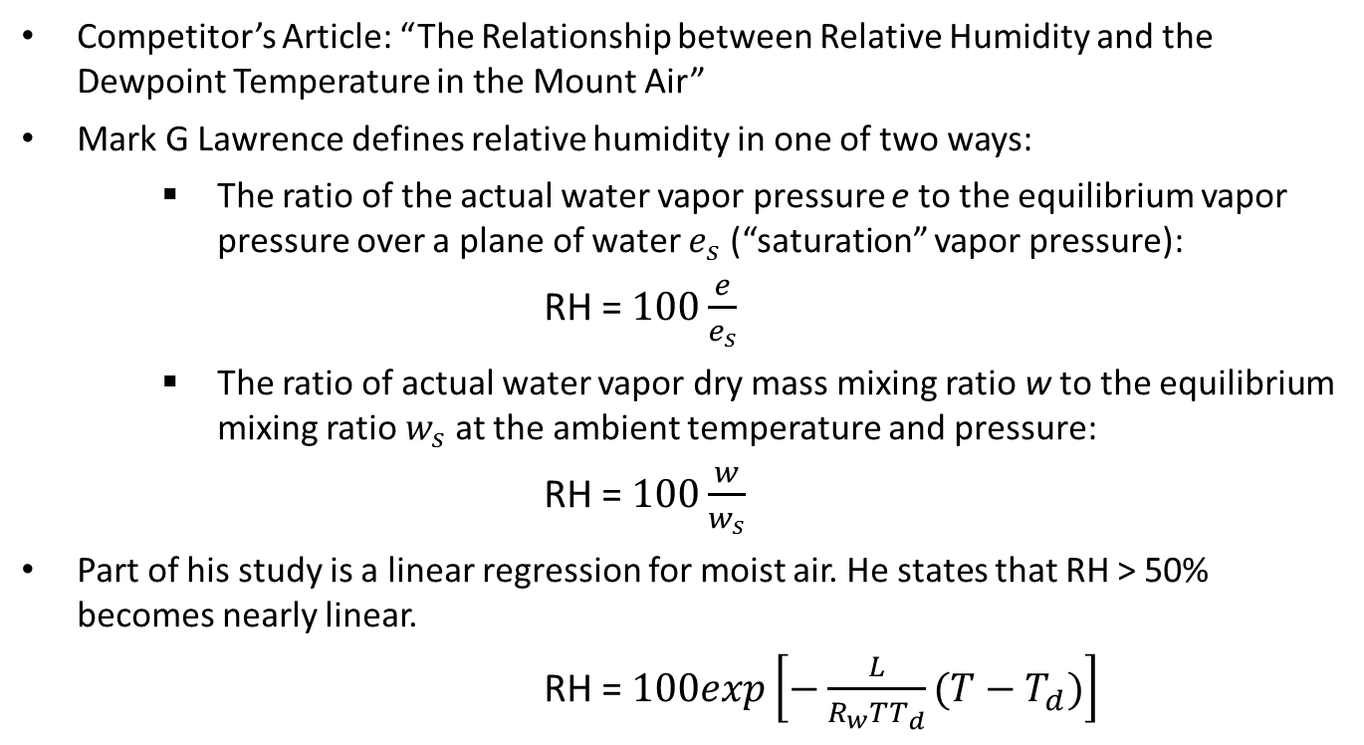
Contribution of Competitor’s Article
Competitor’s Article: “The Relationship between Relative Humidity and the Dewpoint Temperature in the Mount Air”
Mark G Lawrence defines relative humidity in one of two ways:
The ratio of the actual water vapor pressure e to the equilibrium vapor pressure over a plane of water $e_{s}$ (“saturation” vapor pressure):
RH = $100\frac{e}{e_{s}}$
The ratio of actual water vapor dry mass mixing ratio w to the equilibrium mixing ratio $w_{s}$ at the ambient temperature and pressure:
RH = $100\frac{w}{w_{s}}$
Part of his study is a linear regression for moist air. He states that RH > 50% becomes nearly linear.
RH = $100exp\left[−\frac{L}{R_{w}TT_{d}}(T−T_{d})\right]$

Slide 3
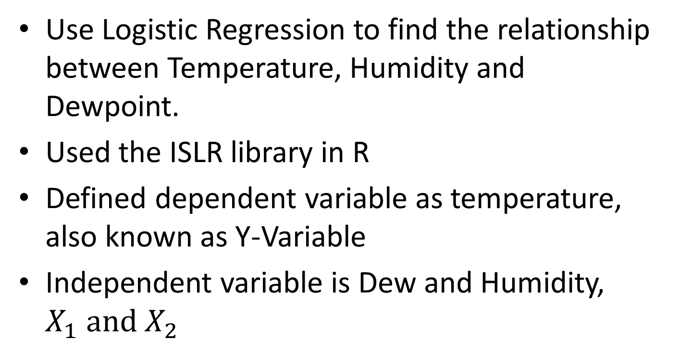
Description of Your Contribution
Use Logistic Regression to find the relationship between Temperature, Humidity and Dewpoint.
Used the ISLR library in R
Defined dependent variable as temperature, also known as Y-Variable
Independent variable is Dew and Humidity, $X_{1} and{ X}_{2}$

Slide 4
Data Source and Content
Data is from the CityPulse dataset collection from city Denmark
Contains Date, Time, Temperature, Dew Point, Humidity, Wind Speed, Wind Direction and Visibility.
Data was collected from February 2014 to September 2014.
Data gap in June.

Slide 5
Your Method
Data Aggregation (Downloading and Uploading)
Data Cleansing (Excel)
Data Modeling (Dependent on the tool used)
Data Analysis (R, Zeppelin, Tableau, MS Excel)
Findings (Tableau)
Conclusion (Zeppelin, R, Tableau)

Slide 6
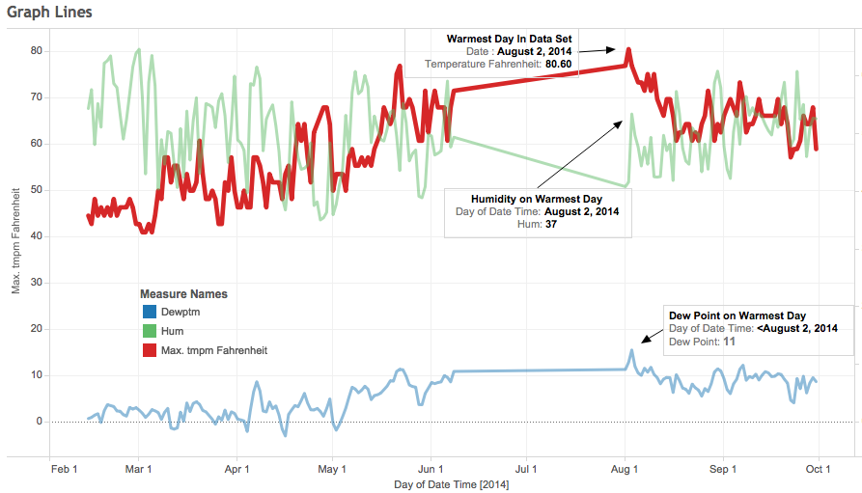
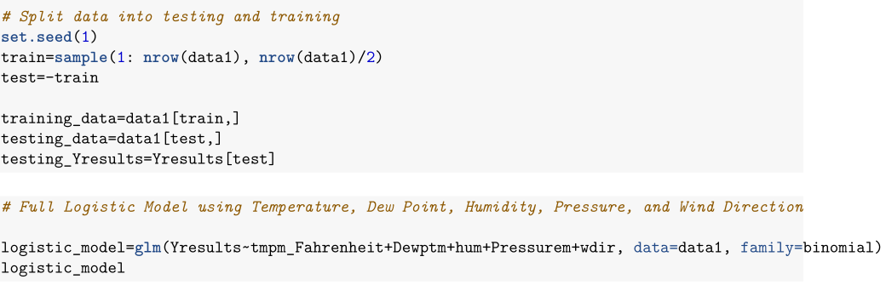
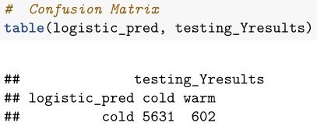
Quantitative Results 1
Used Tableau to visualize data set
Find a relationship between Temperature, Dewpoint and Humidity.
Split data into training data and test data.
Using Logistic Regression to predict temperature using a test data set.
Confusion matrix tells us number of warm days and cold day on test data

Slide 7
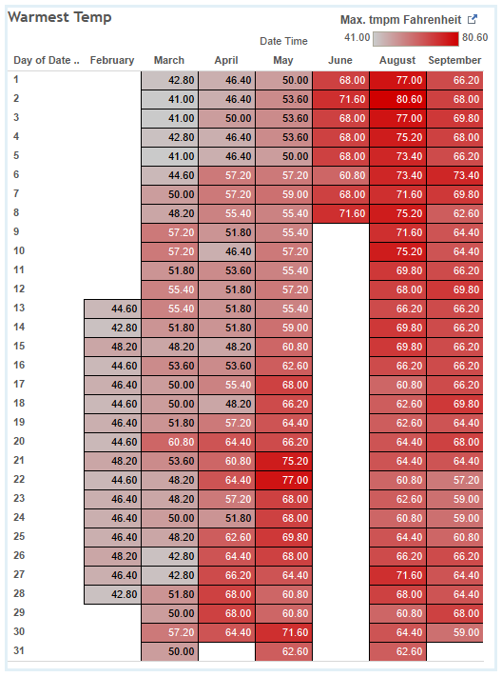
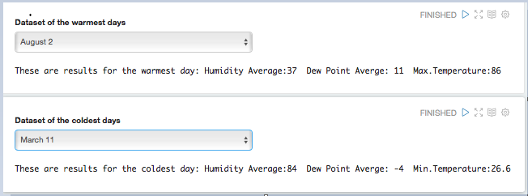
Quantitative Results 2
Tableau present a different visual representation of weather trends for 2014.
Aggregating the data using Zeppelin to create a subset of warmest and coldest day.
Gave the ability to extract the temperature, dew point (average), and humidity (average).

Slide 8
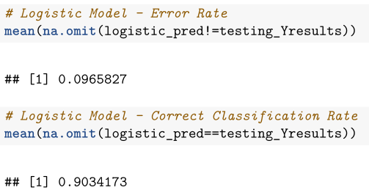
Discussion: Comparison With Your Competitor
Competitor’s Results
Your Results
Error rate of <5%, (basic range of RH ~90% vs 70%)
Direct relationship between temperature, humidity and dew point
Decision was based on binary response of temperature. 65⁰ was the threshold.
Using logistic regression, the model was able to predict a 90.3% accuracy rate on the test data.
My work outperforms my competitor’s work.

Slide 9
Performance on Big Data: Time Measurements
Data download: 10 min
Data upload: 60 sec
Data Conversion: 1 hours (Json to CSV)
Data cleansing: 3 hours
Data exploration: 3 Days
Data Analysis: 20 sec
Data Visualization: 3 hours

Slide 10
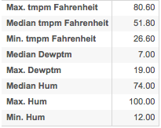
Conclusion
Agree with competitor that there is a direct relationship with temperature, humidity and dew
From the dataset, the warmest day was on August 2, 2014 at 80.6⁰ F, with average humidity of 37 and dew point of 11.
Coldest day was on March 11 at 26.6⁰ F, with average humidity of 84 and dew point of -4.

Slide 11
Quiz for Your Classmates
What statistical method was used?
What programming tool was used?
What scientific contribution was made?
What idea could be useful for your project?

